Slide 1
AIR CRASH SITE TRACKING USING PSO

Slide 2
ABSTRACT
Whenever there is a plane crash in the ocean, it is necessary to reach the crash site for a rescue mission quickly. Any delay in reaching the crash site may result in loss of lives, loss of wreckage deep into the sea & loss of black box which is very important for investigation of the air crash.

Slide 3
BASIC IDEA OF PSO
Each particle is searching for the optimum.
Each particle is moving and hence has a velocity.
Each particle remembers the position it was in where it had its best result so far (its personal best).
But this would not be much good on its own; particles need help in figuring out where to search.

Slide 4
BASIC IDEA OF PSO
The particles in the swarm co-operate. They exchange information about what they’ve discovered in the places they have visited.
The co-operation is very simple. In basic PSO it is like this:
A particle has a neighborhood associated with it.
A particle knows the finesses of those in its neighborhood, and uses the position of the one with best fitness.
This position is simply used to adjust the particle’s velocity

Slide 5
Proposed Solution
This problem can be solved by using particle swarm optimization.
The coordinates (x, y) of the air crash site will be shared among all the boats for a rescue mission.
The boats(particles) will basically use the knowledge of other particles to change their position and reach the destination quickly.

Slide 6
Algorithm
Each boat will be assigned an initial location & velocity.
Fitness value of each boat will be maintained in a list. This fitness function is nothing but the calculation of Euclidean distance from the particles current position and the destination coordinates.
Personal best & Personal best location of each boat is the corresponding fitness value and the current location.

Slide 7
Algorithm Continued…
LOOP UNTIL t < 100 & err >ERR_TOLERANCE
Update Personal best
If fitness value is less than personal best
update the personal best of that swarm with the fitness value.
update the personal best location with current location of boat
Update Global best
Get the index of the minimum value from the fitness value list
Get the value from the fitness value list using that index
If the value is less than global best
Update the global best with that value
Update global location with the location of the best swarm in fitness list

Slide 8
Algorithm Continued…
LOOP FOR EACH SWARM (BOAT)
Update Velocity of boat
newVel[i] = (w * p.getVelocity().getPos()[0]) +
(r1 * C1) *
(pBLoc.get(i).getLoc()[0] - p.getLocation().getLoc()[0]) +
(r2 * C2) * (gBLoc.getLoc()[0] - p.getLocation().getLoc()[0]);
newVel[i] = (w * p.getVelocity().getPos()[1]) +
(r1 * C1) *
(pBLoc.get(i).getLoc()[1] - p.getLocation().getLoc()[1]) +
(r2 * C2) * (gBLoc.getLoc()[1] - p.getLocation().getLoc()[1]);

Slide 9
Algorithm Continued…
Update Location of boat
newLoc[0] = p.getLocation().getLoc()[0] + newVel[0];
newLoc[1] = p.getLocation().getLoc()[1] + newVel[1];
err = evaluate(gBLoc);
minimizing the functions means it's getting closer to 0
Display global best location x & y coordinates
Display fitness value of Global best location
Update the fitness list

Slide 10
Algorithm Continued…
LOOP FOR EACH SWARM (BOAT) ENDS
LOOP UNTIL t < 100 & err >ERR_TOLERANCE
DISPLAY THE GLOBAL BEST LOCATION (x, y)coordinates which is nothing but the coordinates where the solution is found.

Slide 11
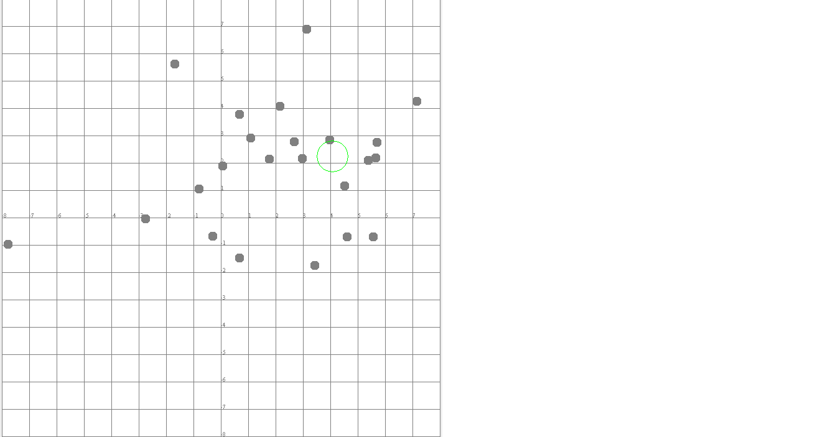
CRASH SPOT IS AT COORDINATES (4,2) – INITIAL PHASE

Slide 12
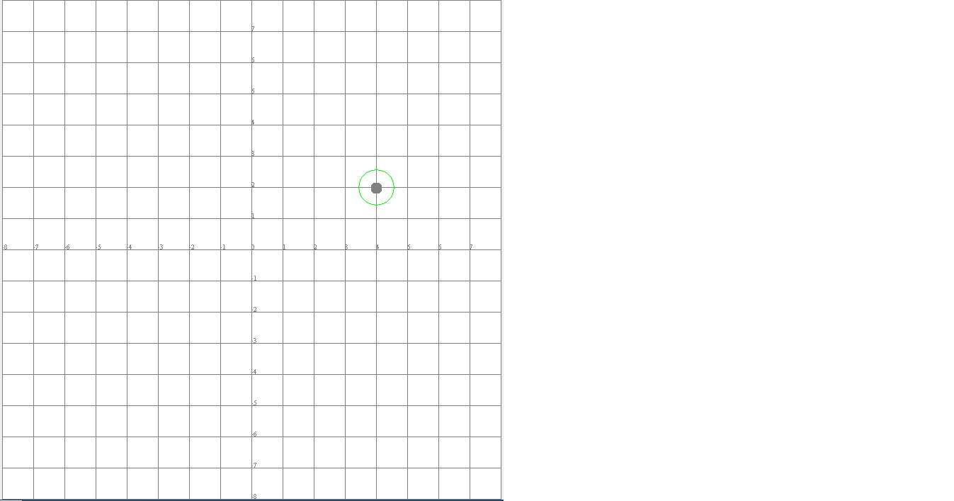
CRASH SPOT IS AT COORDINATES (4,2) – FINAL PHASE

